Slide 1

DEAC
Distance Education Advisory Committee
Tuesday May 26, 2020
1:00pm-2:00pm via Zoom

Slide 2
DEAC ConferZoom Meeting Information
The information below is the ConferZoom information for all DEAC Meetings.
Zoom Topic: DEAC Meeting
Time: This is a recurring meeting Meet anytime
Join from PC, Mac, Linux, iOS or Android: https://cccconfer.zoom.us/j/498385619
Or iPhone one-tap (US Toll): +16699006833,498385619# or +16468769923,498385619#
Or Telephone:
Dial:
+1 669 900 6833 (US Toll)
+1 646 876 9923 (US Toll)
Meeting ID: 498 385 619
International numbers available: https://zoom.us/u/arSbaaODs
Or Skype for Business (Lync):
SIP:498385619@lync.zoom.us
All previous meetings and recordings are available on the Distance Education website at the following link:
http://www.compton.edu/academics/distance-ed/facultyresources.aspx

Slide 3
DEAC Voting Members
Voting members of committee:
    (Quorum = 8 members need to be present to vote)
DSPS/ADA Rep- Cliff Seymour
Student Rep-Vacant
Academic Affairs Rep-Vacant
Counseling - Eckko Blake
Student Services Rep- Syria Purdom
MIS Rep- Andrei Yermakov
Curriculum Committee Chair- Sean Moore
DEFC Co-Chair- Jasmine Phillips
Faculty Reps (GPD)
BIS-Lynda Wilkerson
SS-Dr. Kendahl Radcliffe
FACH-Nikki Williams
STEM-Jose Villalobos
HPS-Dr. Roza Ekimyan
Adjunct Rep-Stephanie Eaves

Slide 4
ConferZoom & Agenda
Call to order: The DEAC meeting was called to order by Jasmine Phillips.
Review and approve the DEAC Agenda
Recorded ConferZoom for this meeting.

Slide 5
Review previous meeting minutes
Recommended Action: It is recommended that DEAC approves the previous meeting minutes as presented.
April 28, 2020
Google Slides
Meeting Minutes

Slide 6
Reports: DE Updates
Guided Pathway Division Reports- Faculty Reps
Curriculum Report- Curriculum Chair
Senate Report- DEFC
FCRC Update- FCRC Chair
Workgroups
  LTI: XYZ Math, WebAssignMath, MyOpenMath, My Lab and Mastering Math, OER Commons, Khan Academy
President/CEO Report-Dr. Curry
DECO: Report- DEFC
DEFC Report

Slide 7
DECO Report
According to the Chancellor’s Office, the statewide Academic Senate, the ACCJC, Title V Ed Code and federal Title IV financial aid language, there is no such thing as remote instruction. There is only distance education and correspondence education. Moving forward all DE requirements and DE laws must be met.
All faculty must comply with all Title V and ADA 508 Accessibility Laws
    All faculty must have regular and effective contact with their students each week
    All materials used must be accessible
    This can be accomplished through both distance education strategies of synchronous or asynchronous course meetings and activities

Slide 8
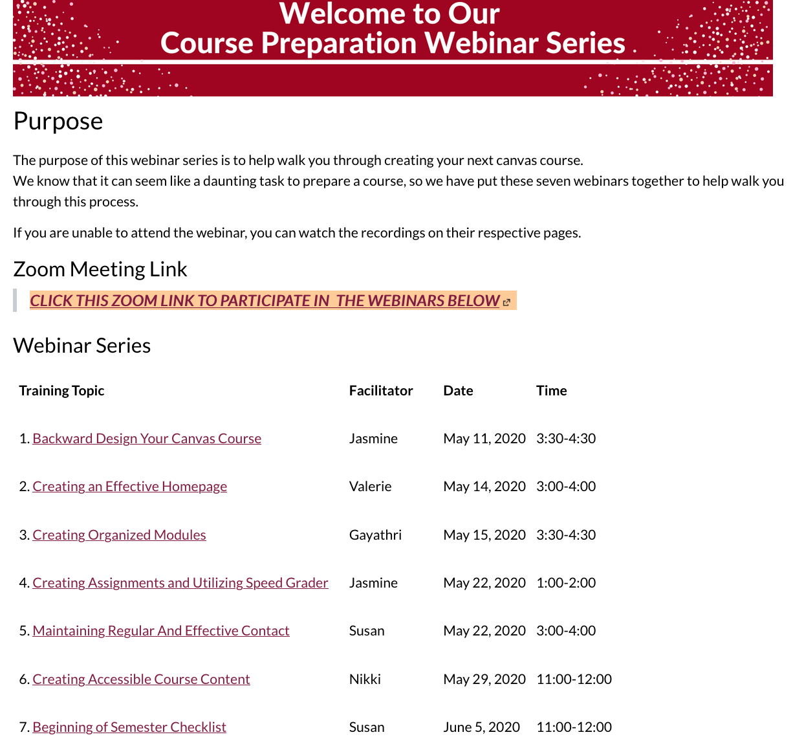
DEFC Report Out
Professional Development Plan
Ally & the new Canvas Rich Content Editor have been turned on in Canvas.
Please install the new zoom update before May 30th.
Published and unpublished courses will now appear in your dashboard separately.

Slide 9
Unfinished Business
None

Slide 10
Actionable and Discussion Items
ASCCC Third Category of Online Classes: Second Read and Vote
New DE Addendum: Second Read and vote
CBA: Online Faculty Evaluation Form: First Read, Second Read and Vote
CBA: Student Online Evaluation Form: First Read, Second Read and Vote
DE Summer Expectations: First Read, Second Read and Vote
DE Program Review Survey questions: First Read
DE Publisher and Website Material Accessibility Policy: First Read, Second Read and Vote
DE Instructional Material Fee and Access Code Policy: First Read, Second Read and Vote
DE Student Authentication Policy: First Read
XYZ Math LTI: First Read
Web Assign Math LTI: First Read
My Open Math LTI: First Read
My Lab and Mastering Math LTI: First Read
OER Commons LTI: First Read
Khan Academy LTI: First Read

Slide 11
Third Category of Distance Education
Second read and vote
Workgroup: Sean, Jasmine
ASCCC’s third definition of online classes:
  Hybrid/Online with in-person Proctored Assessment: Instruction involving regular and effective online interaction in which all instruction takes place synchronously or asynchronously and is supported by online materials and activities delivered through the college's learning management system, with in-person proctored assessments. All assessments are offered at approved locations proximal to the student and over a designated range of dates and times. No activities or assessments may be scheduled at a designated time or location.

Slide 12
New DE Addendum: Second read and vote
Workgroup: Sean and Jasmine
New DE Addendum

Slide 13
CBA: Online Faculty Evaluation Form: First Read, Second Read & Vote
Workgroup: Valerie, Nikki, Susan, Lynda, Jasmine
Online Faculty Evaluation Form

Slide 14
CBA: Online Student Evaluation Form: First Read, Second Read & Vote
Workgroup: Valerie, Nikki, Susan, Lynda, Jasmine
Online Student Evaluation Form

Slide 15
DE Summer and Fall Expectations: First Read, Second Read & Vote
Workgroup: Susan, Jasmine
Academic Senate Faculty Summer and Fall Expectations

Slide 16
DE Program Review Survey: First Read
DE SAO and survey workgroup: Lauren, Jasmine
Survey preview
Table, and redo SAO & survey questions.
Lynda, Nikki, Susan, Denise

Slide 17
DE Publisher and Website Material Accessibility Policy
First Read, Second Read & Vote
Workgroup: Sean, Jasmine
Publisher and Website Material Accessibility Policy

Slide 18
DE Policy Instructional Material Fee and Access Code Policy
First Read, Second Read & Vote
Workgroup: Sean, Jasmine
Instructional Material Fee and Access Code Policy

Slide 19
DE Student Authentication Policy: First Read
Update of existing policy
Student Authentication and Guidelines

Slide 20
XYZ Math LTI: First Read
PRESENTATION OF DISCUSSION
Gayathri Manikandan
RESOURCE
XYZ Homework Math
NOTES
After an accessibility check and a second read the committee will take a vote.

Slide 21
Web Assign Math LTI: First Read
PRESENTATION OF DISCUSSION
Gayathri Manikandan
RESOURCE
Web Assign Math
NOTES
After an accessibility check and a second read the committee will take a vote.

Slide 22
My Open Math LTI: First Read
PRESENTATION OF DISCUSSION
Gayathri Manikandan
RESOURCE
My Open Math
NOTES
After an accessibility check and a second read the committee will take a vote.

Slide 23
My Lab and Mastering Math LTI: First Read
PRESENTATION OF DISCUSSION
Gayathri Manikandan
RESOURCE
My Math Lab
NOTES
After an accessibility check and a second read the committee will take a vote.

Slide 24
OER Commons LTI: First Read
PRESENTATION OF DISCUSSION
Gayathri Manikandan
RESOURCE
OER Commons
NOTES
After an accessibility check and a second read the committee will take a vote.

Slide 25
Khan Academy LTI: First Read
PRESENTATION OF DISCUSSION
Gayathri Manikandan
RESOURCE
Khan Academy
NOTES
After an accessibility check and a second read the committee will take a vote.

Slide 26
Informational Items
Growing With Canvas Payment for Adjuncts
Feedback from divisions for AS 60 rewrite

Slide 27
Growing With Canvas Payment for Adjuncts
The completion list is on the DE Webpage for those who have completed the training.
If adjuncts would like to be paid 4 hours for the training they need to finish the training by June 12th.
If full time faculty would like 4 hours of flex credit then they need to finish the training by June 12th.

Slide 28
Feedback from divisions for AS 60 rewrite
Workgroup: Dr. Valerie Woodward, Nikki
COR Track Changes

Slide 29
Announcements
Structure of the Distance Education Department Statement from the President

Slide 30
Next Meeting
Second read and vote on:
  DE Student Authentication Policy
  DE Program Review Survey questions
  Hybrid Best Practices
Accessibility check and Second read on all LTI’s
Create OOS Policy
Updating DE Handbook
Collaborate with the Accessibility Committee to create an Accessibility Check Policy/Process
Workgroup for revising the AS 60 COR
  Valerie, Nikki, Rashid
Future Agenda Items
2019-2020 DEAC meeting times.
4th Tuesdays of each month from 1:00 - 2:00 pm
Fall 2020: September 22, 2020

