Slide 1
DEAC
Distance Education Advisory Committee
Tuesday March 26th, 2019 12:30pm-1:30pm

Slide 2
CCC Zoom & Agenda
Call to order:The DEAC meeting was called to order at 12:39 by DEFC Jasmine Phillips.
Agenda
Recorded CCCZOOM Meeting Link

Slide 3
DEAC Voting Members
Voting members of committee:
(Quorum=6 members need to be present to vote)
DSPS/ADA Rep- Connie/Cliff Seymour
Student Rep- Nicholas Robinson
Academic Affairs Rep Committee Co-Chair- Dr. Rodney Murray
Counseling - Eckko Blake
Division 1 Rep- Dr. Kent Schwitkis
Division 2 Rep- Mandida Uch
Division 3 Rep- Dr. Malinni Roeun
Student Services Rep- Syria Purdom
MIS Rep- Andrei Yermakov
Curriculum Committee Chair- Dr. Roza Ekimyan
DE Faculty Coord. Committee Co-Chair- Jasmine Phillips

Slide 4
Previous meeting minutes
Recommended Action: It is recommended that DEAC approves the previous meeting minutes as presented.
Motion: Uch
Second: Murray
February 26, 2019 meeting

Slide 5
DE Updates
Division 1, 2 & 3 Reps Report - Dr. Schwitkis, Dr. Roeun & Uch
Curriculum Report - Dr. Ekimyan
Senate Report -DEFC
DECO: Report DEFC
IEPI: April 29th meeting date has been set
Update: None at this time
Canvas: Administrative implementation calls have begun
Canvas Administrator/LMS Technician Position:
Dr. Curray stated that he would like DEAC to review the job description and make recommendations on the position duties before the matter is brought up at the April 19th Board meeting

Slide 6
Distance Education Advisory Committee Handbook Statement
In support of the institution’s Mission, Vision, Quality Focused Essay (QFE) and Master Plan, Compton Colleges’ Distance Education Advisory Committee (DEAC) will work with the Deans, the Distance Education Faculty Coordinator (DEFC), Curriculum Committee, Academic Senate as instructional program leaders to facilitate and improve online teaching, learning and technology.
With the understanding that faculty should have the primary responsibility for developing policies and promoting Distance Education practices, DEAC will support a learner-centered program designed to further student success by making recommendations to Curriculum and reporting to Academic Senate. Each DEAC member will represent his/her division/department and act as a resource to all faculty and staff members within their division regarding exploration, development and implementation of strong pedagogical online strategies in the Distance Education environment. Also, departments such as the library and student services etc. will collaborate with DEAC to strategize ways to enhance the online experience for our students.
DEAC, co-chaired by DEFC and the division Dean, is a Senate subcommittee and operates under Senate authority. In this context specifically, the DEFC has a reporting responsibility to Academic Senate and sits on the Curriculum Committee as a voting member.

Slide 7
DEAC
The purpose of DEAC according to the ASCCC
Development of recommendations and approval from appropriate faculty groups of instructional design standards for online courses;
Review of course shells in the course management system (CMS) to ensure that they comply with the college’s instructional design standards;
Recommendations on the development of policies regarding the distance education program, including policies for the ongoing professional development for distance education instructors, policies regarding training in the use of the CMS, and policies for ensuring that all courses and materials are accessible to all people with disabilities;
Development of the college distance education plan;
Drafting of the college distance education handbook;
Processes for peer review and professional development in the college distance education program to ensure its overall quality so that all accreditation requirements are being met and that students are being well-served.
IEPI raised the question, “What is the purpose of DEAC?”
ASCCC document: Ensuring an Effective Online Program: A Faculty Perspective

Slide 8
DEAC
The purpose of DEAC according to the ASCCC
Instructional Design: Committee will begin to discuss institutional standards for how Canvas should be used by DE faculty (i.e. selecting a standard campus wide home page etc.)
Review Course Shells: Subcommittee member will take an active role in the initial Canvas demonstration of competency for faculty
DE Policies on PD for DE instructors: Refer to handbook
Accessibility policies for DE instructors: Refer to OEI Rubric
Development of the college distance education plan: DE Plan which includes our DE goals.
Drafting of the college distance education handbook: DE Handbook
Processes for peer review and professional development: POCR Process
IEPI raised the question, “What is the purpose of DEAC?”
ASCCC document: Ensuring an Effective Online Program: A Faculty Perspective

Slide 9
QFE Distance Education Goals
The Distance Education Department has three goals as established in the Quality Focus Essay.
Create a clear organizational management structure for Distance Education
Implement best practices to increase online student success
Promote student awareness of Distance Education resources and develop new tools to facilitate success

Slide 10
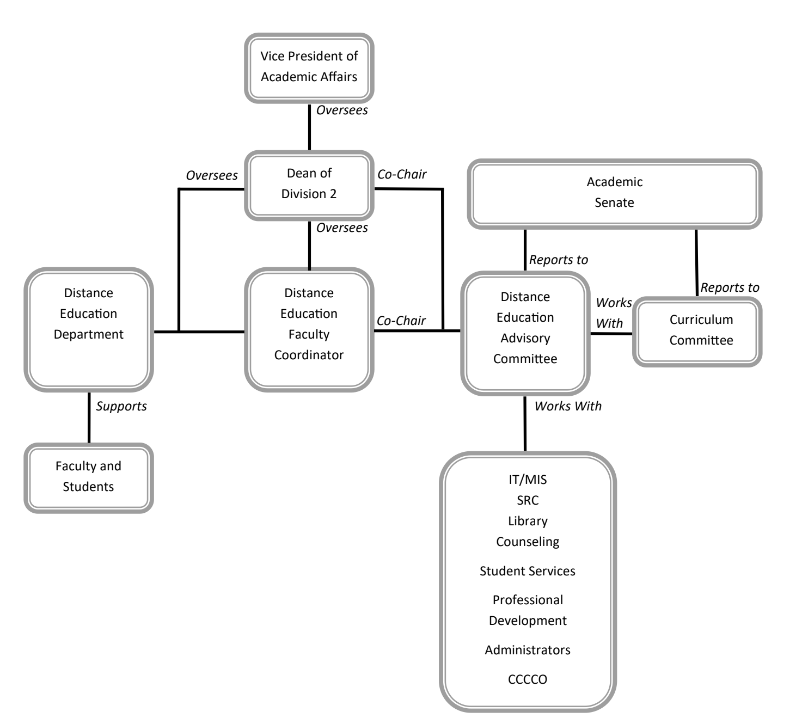
DE Organizational Chart

Slide 11
Today’s Votes
POCR Process is open for discussion
Peer Online Course Review
Stages of POCR
Vote on approving the POCR Process
The motion will be to approve the DE Faculty Peer Online Course Review Process given any stated changes.
Changes: no stated changes
Motion: uch
Second: Cliff
Yes: 7
No: 1
Abstentions: 0
The DE POCR Process will be brought before Academic Senate

Slide 12
Today’s Votes
Second Read of the DE Program Plan
Open for discussion
Vote on approving the DE Program Plan
The motion will be to approve the DE Program Plan given any stated changes.
Changes: No changes stated
Motion: Roza
Second: Nick
Yes: 8
No: 0
Abstentions: 0
The DE Plan will be brought before Academic Senate

Slide 13
Next Meeting
Topics to discuss:
Canvas Implementation by June 7th 2019
Partnerships:
IEPI
Joining the CVC-OEI Consortium
Tuesday April 30th, 2019 12:30pm-1:30pm

Slide 14
Visit From President Dr. Curry
Dr. Curry has been invited to address the committee.
Dr. Curry stated that he would like DEAC to:
Review the LMS position and make recommendations on job duties
Have Andrei present to the committee on BlackBelt help
The contract with BlackBelt Help will go before the board at the April 19th Board Meeting
Generate a plan moving forward addressing if we should offer fully online programs
Determine if we as a campus should increase our online offerings
Construct a path to offering online resources to students such as online counseling etc.
Find out where the money should come from to pay the POCR’s

Slide 15
DE Resources
@One Course Resources
First Fridays with @one
Byte Sized Canvas with @one
Flex Reporter is Live at Compton College
OEI Rubric; OEI 2018 Rubric
OEI Course Design Guide
OTC Conference 2019 Anaheim, CA June 17-19, 2019: Submit paperwork
Instructurecon July 9-11th in Long Beach: Submit paperwork
DE Meeting Notes
Captioning Resources: 3cMedia

Slide 16
Meeting Attendees
Jasmine Phillips - Voted
Dr. Rodney Murray - Voted
Cliff Seymour - Voted
Mandeda Uch
Nicholas Robinson - Voted
Judith Crozier
Katherine Marsh
Celia Valdez
Nikki Williams
Roza Ekimyan - Voted
Dr. Kent Schwitkis - Voted
Syria Purdom - Voted
Andrei Yermakov - Voted
Dr. Joan Thomas-Spiegel
Dr. Keith Curry
Meeting adjourned at: 1:35 pm Motion: Roza Second: Nick

