Slide 1
Institutional Capacity Assessment Tool
LEVELS KEY
LEVEL 1
Minimal level of capacity in place with a clear need to build strength.
LEVEL 2
Moderate level of capacity established.
LEVEL 3
Strong level of capacity in place.
LEVEL 4
Exemplary level of capacity in place.
157 Respondents
71 staff
25 administrators
41 full-time faculty
14 adjunct faculty
6 other

Slide 2
Institutional Capacity Assessment Tool
LEVELS KEY
LEVEL 1
Minimal level of capacity in place with a clear need to build strength.
LEVEL 2
Moderate level of capacity established.
LEVEL 3
Strong level of capacity in place.
LEVEL 4
Exemplary level of capacity in place.
157 Respondents
71 staff
25 administrators
41 full-time faculty
14 adjunct faculty
6 other
Potential themes for our Capacity Café event on March 19, 2021

Slide 3
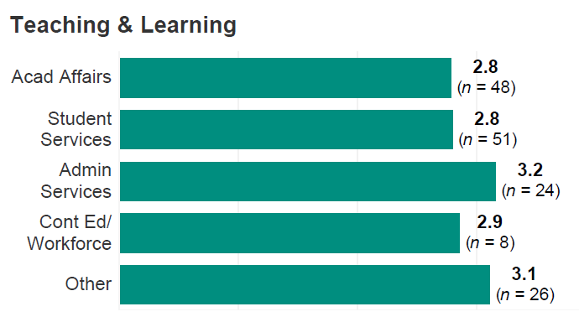
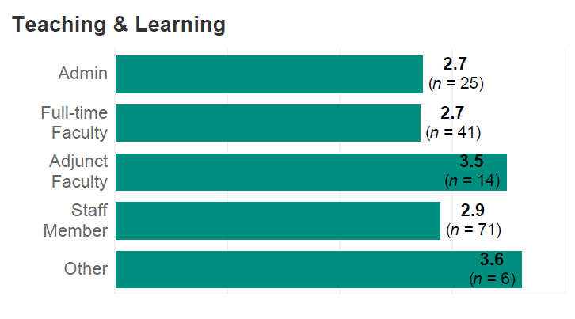
Teaching and Learning
2.8 overall rating
Areas rated at low capacity by respondents (areas for growth):
Faculty demonstrate evidence-based, innovative, and reflective teaching practices as a result of professional development
Professional development meets the needs of faculty (full-time and adjunct) at various stages of their career
Teaching excellence integrated with institutional hiring, retention and promotion policies and practices
Institution provides early career guidance to help all students make informed career choices leading to high demand jobs and increased earning potential
Rating by area:
Rating by employee type:

