Slide 1
Measuring our Success for Improvement

Slide 2
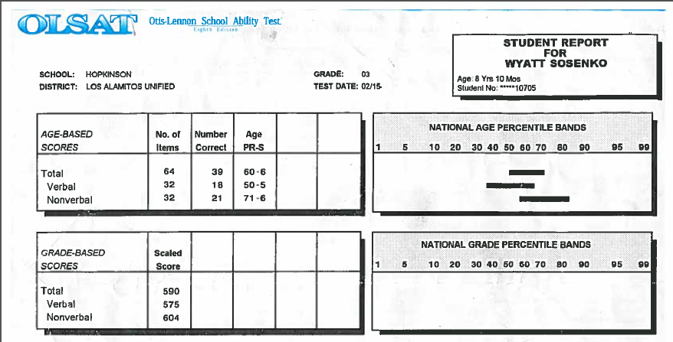
“You are such a data nerd.” –Mike Sosenko

Slide 3
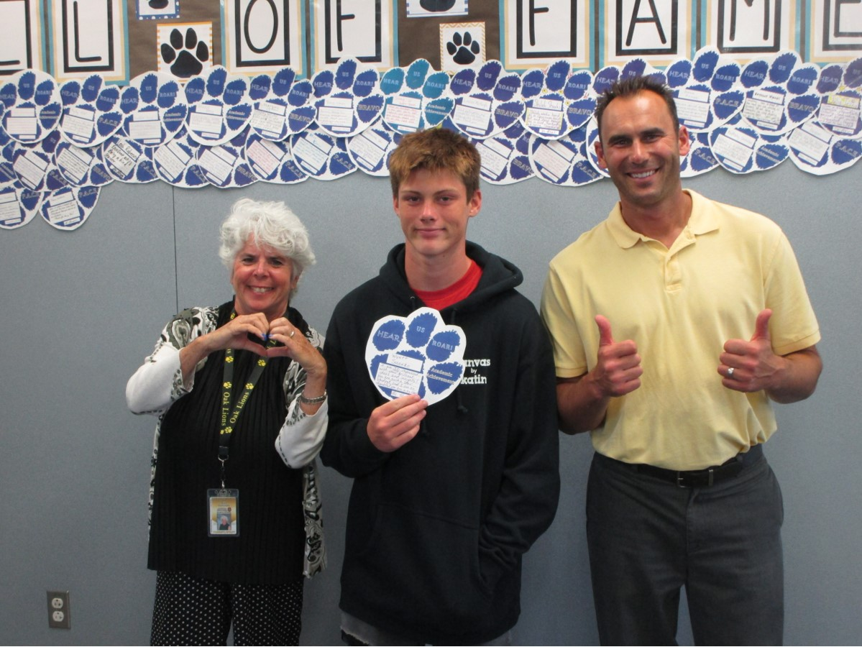

Slide 4
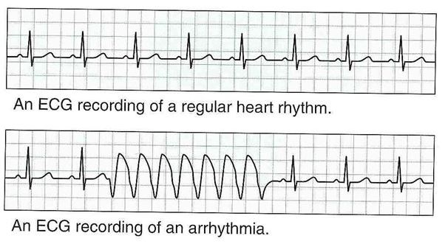

Slide 5
Pair Share
What is your data language?

Slide 6
What will we accomplish today?
Review Institutional Set Goals, Targets
Brainstorm stronger leading measures for these outcomes
Link to next year’s plan

Slide 7
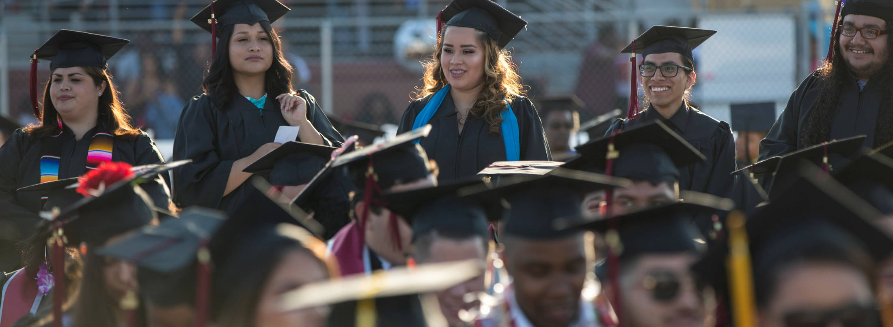
How are we using data now?

Slide 8
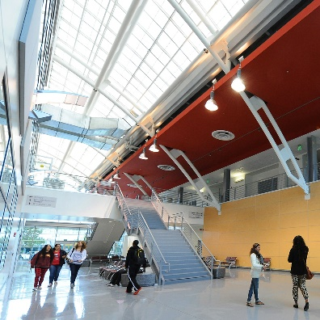
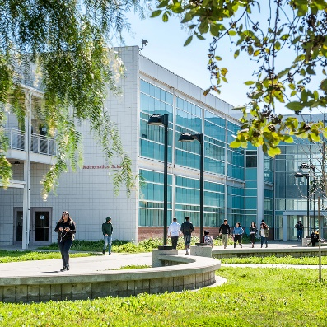
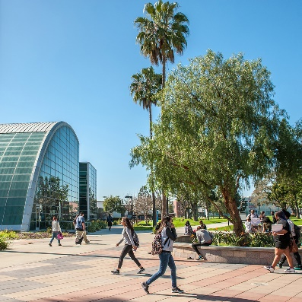
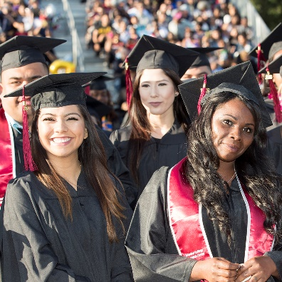
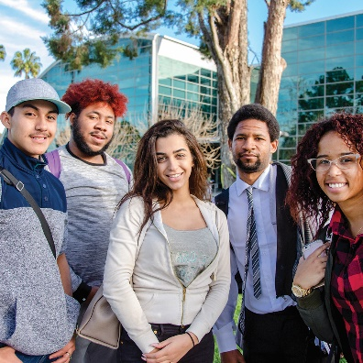
Tartar Completion by Design
CONNECTION
Initial Interest through
Submission of Application
ENTRY
Enrollment through
Completion of
“Gatekeeper” Courses
PROGRESS
Entry into Course of Study through Completion of 75% of Requirements
COMPLETION
Complete Course of Study through Earning a Credential with Labor Market Value
TRANSITION
Movement to Four-Year University or to Workplace
with Living Wage

Slide 9
Institutional Set Goals
Measure | 2016-17 Baseline | 2017-18 Most Recent | 2021-22 Goal (Assessed Annually)
Successful Enrollment (Applicant yield rate) | 42.3% 8,320 students | 42.0% 8,151 students | 44.8% 8,702 students
CONNECTION
Initial Interest through
Submission of Application
Current Baseline (2017-18) Disp. Impacted Students
American Indian / Alaskan Native | 28% | 34%
Black or African American | 36% | 39%
Pacific Islander | 34% | 38%
White | 32% | 36%
Disabled | 37% | 42%
Foster Youth | 33% | 40%
LGBT | 37% | 42%
Veteran | 34% | 40%

Slide 10
Institutional Set Goals
Measure | 2016-17 Baseline | 2017-18 Most Recent | 2018-19 | 2021-22 Goal (Assessed Annually)
Number of Dual Enrollment Students | 1,114 | 1,131 | 1,253 | 1,206
Student Readiness Rate (Core Service Completion) | 54.7% | 72.3% |  | 100.0%
All Students’ Fall-to-Spring Persistence Rate | 57.5% 3,747 Students | 53.7% 3,652 Students | 53.1% 3,600 Students | 57.3% 3,899 Students
First-Time Full-Time Students Returning after One Academic Year | 55.7% 231 Students | 59.7% 230 Students | 57.4% 228 Students | 63.7% 245 Students
Completion of Transfer-Level English in First Year | 15.7% 185 Students | 13.6% 142 Students | 14.2% 138 Students | 27.0%^{VS} 281 Students
Completion of Transfer-Level Math in First Year | 3.1% 36 Students | 3.1% 32 Students | 3.2% 24 Students | 11.0%^{VS} 114 Students
ENTRY
Enrollment through
Completion of
“Gatekeeper” Courses

Slide 11
Institutional Set Goals
All Students’ Fall-to-Spring Persistence Rate | 57.5% 3,747 Students | 53.7% 3,652 Students | 53.1% 3,600 Students | 57.3% 3,899 Students
Current Baseline (2017-18) Disp. Impacted Students
Black or African American | 49% | 52%
First Generation | 50% | 54%
Foster Youth | 42% | 50%
Veteran | 36% | 46%
Male & 20 to 24 | 49%
Male & 25 to 29 | 43%
Male & 35 to 39 | 43%
Male & Asian | 34%
Male & Black or African American | 45%
Male & White | 33%
Male & First Generation | 48%
Male & Foster Youth | 35%
ENTRY
Enrollment through
Completion of
“Gatekeeper” Courses

Slide 12
Institutional Set Goals
Measure | 2016-17 Baseline | 2017-18 Most Recent | 2018-19 | 2021-22 Goal (Assessed Annually)
Course Success Rate (Institution-Set Standard = 62.6%) | 68.1% 26,023 Grades | 68.9% 24,474 Grades | 66% 23,156 Grades | 73.5% 26,108 Grades
On-Campus Success Rate | 68.8% 23,978 Grades | 69.4% 21,860 Grades | 66.% 18,515 Grades | 74.0% 23,256 Grades
Distance Ed. Course Success Rate | 61.3% 3,337 Grades | 63.1% 4,066 Grades | 66.1% 4,641 Grades | 67.3% 4,335 Grades
Average Units Completed per Academic Year (Part-Time) | 6.7 | 6.5 | 6.4 | 12.0
Average Units Completed per Academic Year (Full-Time) | 20.6 | 23.6 | 22.4 | 24.0
PROGRESS
Entry into Course of Study through Completion of 75% of Requirements

Slide 13
Purposes of data use
Report
Advocate
Improve

Slide 14
Report
Advocate
Improve

Slide 15
Report
Advocate
Improve

Slide 16
Improve
What are the key ways you want to improve?
CONNECTION
Initial Interest through
Submission of Application
ENTRY
Enrollment through
Completion of
“Gatekeeper” Courses
PROGRESS
Entry into Course of Study through Completion of 75% of Requirements
Did we make any progress in 2018-19?
How are departments doing this work measuring success?
How can we link department measures to these measures?

Slide 17
What is a logic model?
Process
Outcomes
if
then
if
then
if
then
if
then
Inputs
Activities
Outputs
Leading
Lagging

Slide 18
Leading and Lagging Indicators
Leading indicators
Reflect students’ current needs
Can predict future success/failure
Are relatively in one’s control
Lagging indicators
Reflect how things ended up
Tracking trends
Notes:
People care about:
⬥ What they have some influence over
⬥ What they are accountable for
➢ They do not care about what they cannot influence
⬥ If they are made responsible for outcomes they cannot influence, they shut down, sabotage, fake data, etc.

Slide 19
Survey

Slide 20
Thank You!
QUESTIONS?
Lauren Sosenko
Director, Institutional Effectiveness
lsosenko@compton.edu

